Slide 1
Using WebSockets in Web apps
Presenter: Shahzad Badar

Slide 2
Agenda
Who am I?
WebSockets Introduction
WebSockets support in Java EE 7

Slide 3
Who am I?
A Java evangelist working on java since 2002
Leading Pakistan JUG
Working in Primatics Financials

Slide 4



Catch me
@shahzadbadar
shahzadbadar@gmail.com
http://www.implementsjava.com

Slide 5
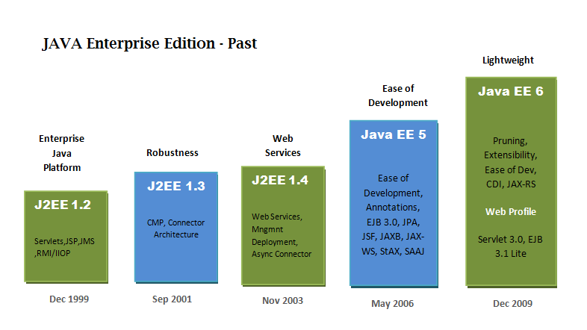

Slide 6
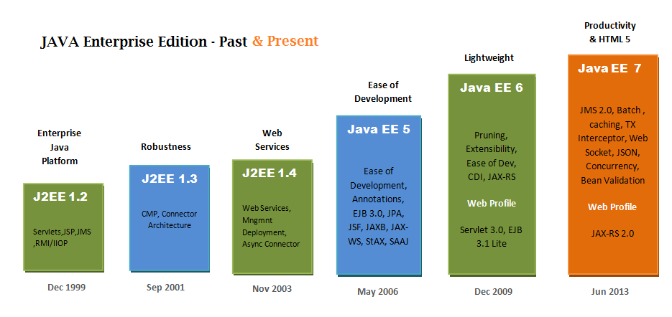

Slide 7
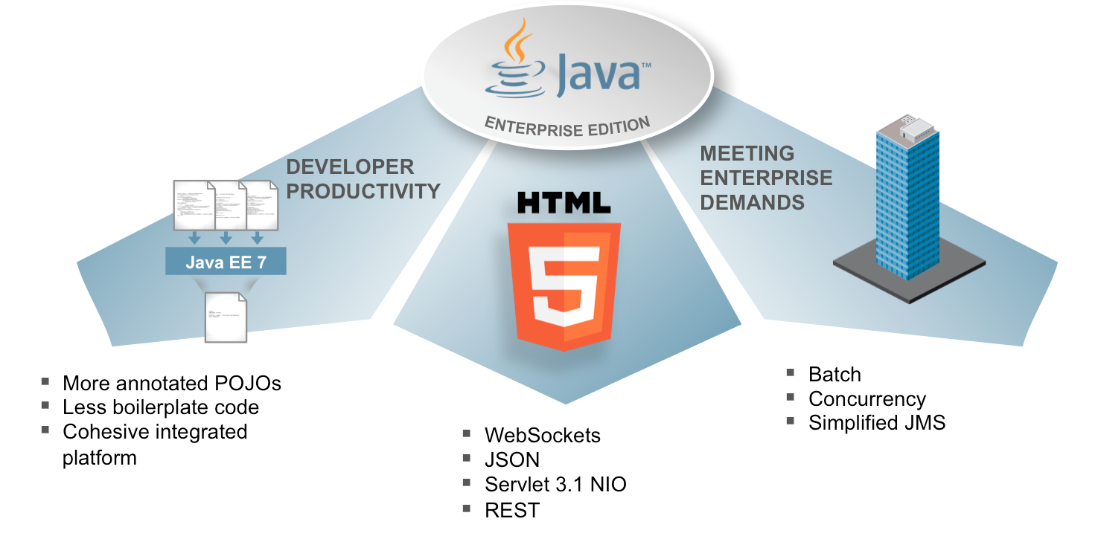
JEE 7 Theme

Slide 8
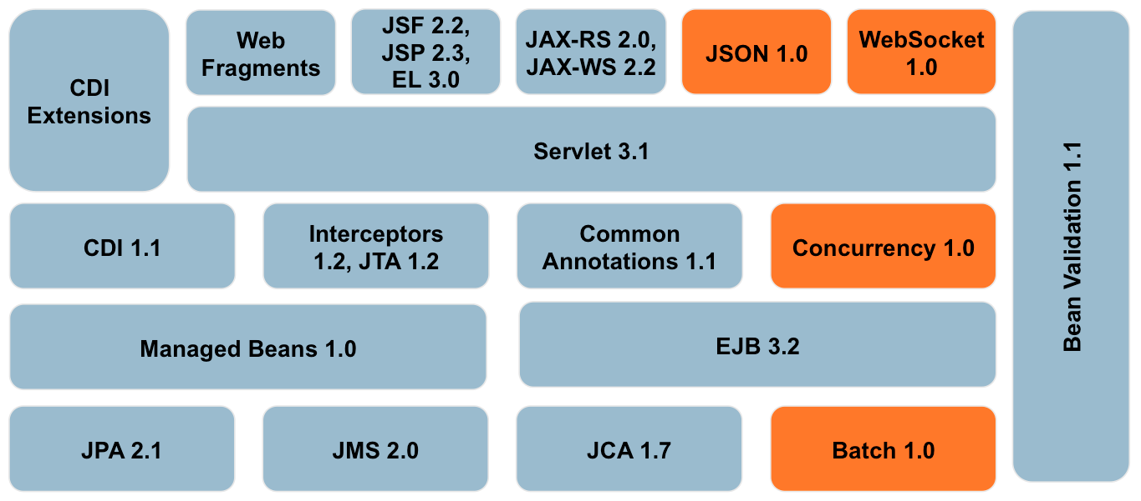

Slide 9
Active JSRs
JSR 342: Java EE 7 Platform
JSR 338: Java API for RESTful Web Services 2.0
JSR 339: Java Persistence API 2.1
JSR 340: Servlet 3.1
JSR 341: Expression Language 3.0
JSR 343: Java Message Service 2.0
JSR 344: JavaServer Faces 2.2
JSR 345: Enteprise JavaBeans 3.2
JSR 346: Contexts and Dependency Injection 1.1
JSR 349: Bean Validation 1.1
JSR 236: Concurrency Utilities for Java EE 1.0
JSR 352: Batch Applications for the Java Platform 1.0
JSR 353: Java API for JSON Processing 1.0
JSR 356: Java API for WebSocket 1.0

Slide 10
Web Socket Support
In age of Web 2.0 / 3.0 , We need interactive websites
but
In the standard HTTP model, a server cannot initiate a connection with a client nor send an unrequested HTTP response to a client; thus, the server cannot push asynchronous events to clients.

Slide 11
Why WebSocket?
HTTP was good enough for simpler World
AJAX – start of bidirectional communication (2005)
Today, Web apps demand reliable “real-time” communication with minimal latency
  Social media apps
  Financial applications
  Online games
  Collaborative Platforms
  etc …

Slide 12
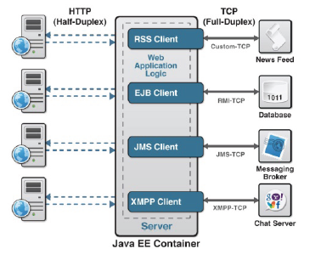
Why WebSocket?
It’s hard to achieve real-time web apps, primarily due to limitations of HTTP
HTTP is half duplex ( traffic flows in only one direction at a time)
HTTP is verbose
HTTP adds latency, latency sucks

Slide 13
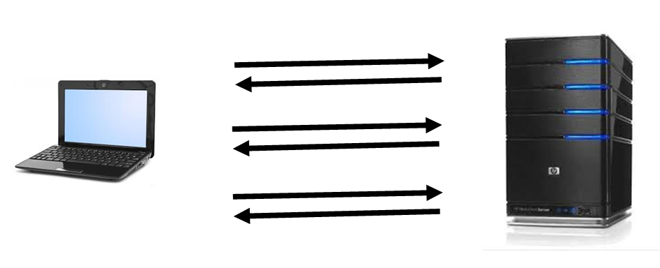
HTTP Communication

Slide 14
Simulating full-duplex
Tricks
  Polling
  Long-polling
  HTTP Streaming
Significant resource consumption overhead
Lots of complexity
  Requesting each n second
  Maintaining more than one connections

Slide 15
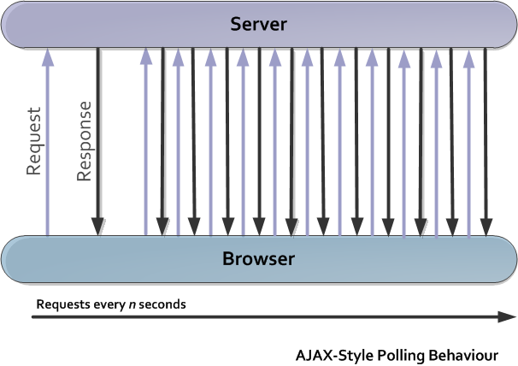
Polling

Slide 16
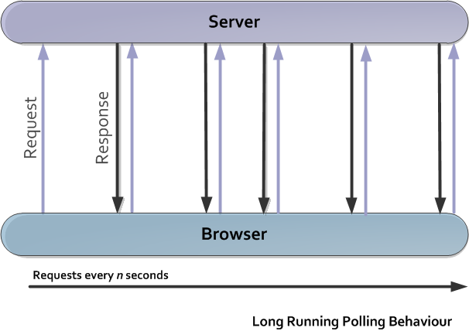
Long Polling

Slide 17
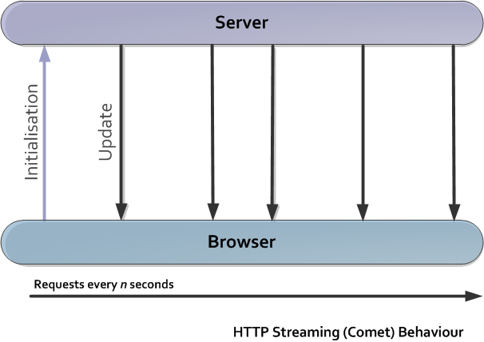
HTTP Streaming (Comet)

Slide 18
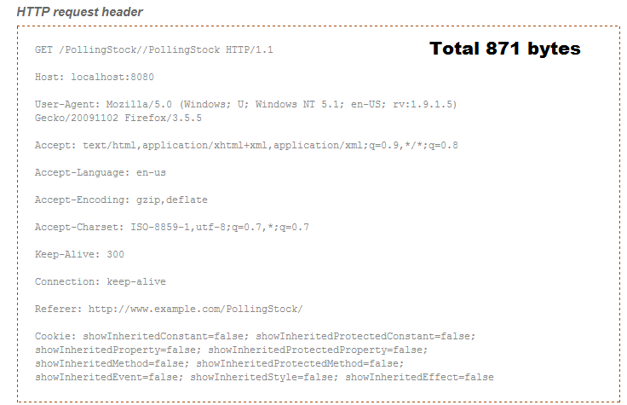
HTTP Request overhead

Slide 19
Network throughput for just the HTTP
Use case A: 1,000 clients polling every second: Network throughput is (871 x 1,000) = 871,000 bytes = 6,968,000 bits per second (6.6 Mbps)
Use case B: 10,000 clients polling every second: Network throughput is (871 x 10,000) = 8,710,000 bytes = 69,680,000 bits per second (66 Mbps)
Use case C: 100,000 clients polling every 1 second: Network throughput is (871 x 100,000) = 87,100,000 bytes = 696,800,000 bits per second (665 Mbps)

Slide 20
WebSocket to rescue
TCP based, bi-directional, full-duplex messaging
Capable of sending both UTF-8 string and binary frames in any direction at the same time
Operating from a single socket across the web
As part of HTML5, the application of the client interface will become native to all modern browsers
To establish a Web Socket connection, the browser or client simply makes a request to the server for an upgrade from HTTP to a Web Socket

Slide 21
HTML5 Web Sockets!
Use case A: 1,000 clients receive 1 message per second: Network throughput is (2 x 1,000) = 2,000 bytes = 16,000 bits per second (0.015 Mbps) [was 6.6 Mbps]
Use case B: 10,000 clients receive 1 message per second: Network throughput is (2 x 10,000) = 20,000 bytes = 160,000 bits per second (0.153 Mbps) [was 66 Mbps]
Use case C: 100,000 clients receive 1 message per second: Network throughput is (2 x 100,000) = 200,000 bytes = 1,600,000 bits per second (1.526 Mbps) [was 665 Mbps]

Slide 22
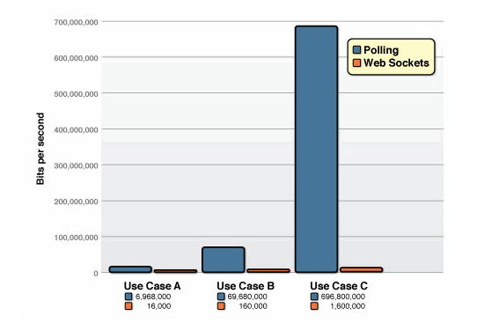
Comparison of the unnecessary network throughput overhead

Slide 23
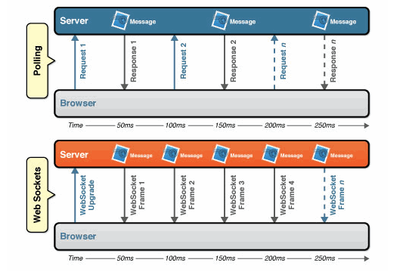
Latency comparison

Slide 24
Web Sockets - Win
HTML5 Web Sockets can provide a 500:1 or—depending on the size of the HTTP headers—even a 1000:1 reduction in unnecessary HTTP header traffic
3:1 reduction in latency.

Slide 25

“Reducing kilobytes of data to 2 bytes…and reducing latency from 150ms to 50ms is far more than marginal. In fact, these two factors alone are enough to make Web Sockets seriously interesting to Google.”

Slide 26
Web Sockets
The WebSocket specification defines an API establishing "socket" connections between a web browser and a server. In plain words: There is an persistent connection between the client and the server and both parties can start sending data at any time.

Slide 27
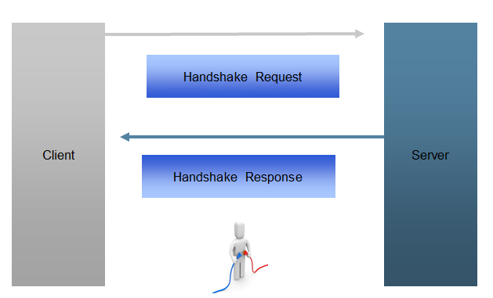
Establishing a connection

Slide 28
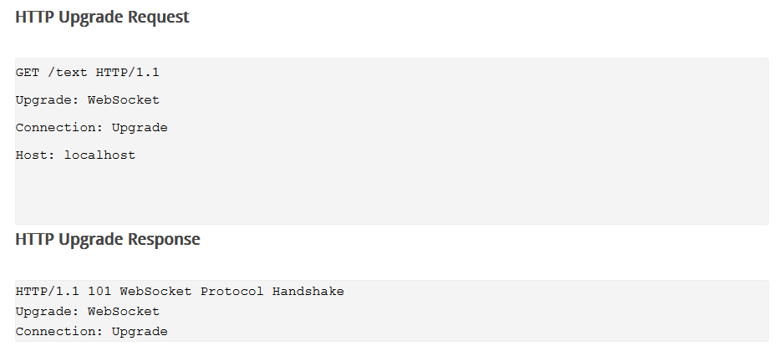
Handshake Request/Response

Slide 29
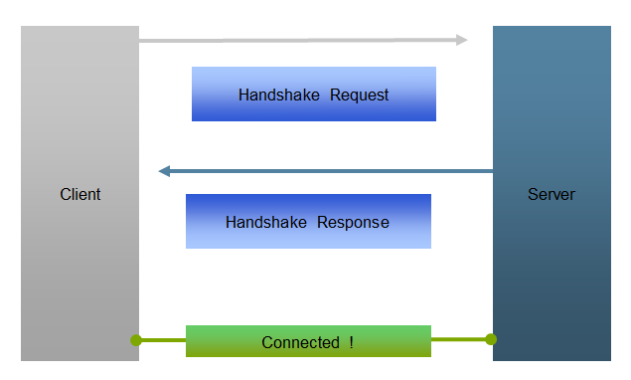
Establishing a connection

Slide 30
WebSocket Lifecycle
Client
Connected !
Server
open
open
message
message
error
message
message
close
Disconnected
Notes:
30

Slide 31
Getting Started
You open up a WebSocket connection simply by calling the WebSocket constructor:
var connection = new WebSocket('ws://localhost:8080/chat', ['soap', 'xmpp']);
Notice the ws:. This is the new URL schema for WebSocket connections. There is also wss: for secure WebSocket connection the same way https: is used for secure HTTP connections.

Slide 32
Getting Started
// When the connection is open, send some data to the server
connection.onopen = function () {
connection.send('Ping'); // Send the message 'Ping' to the server
};
// Log errors
connection.onerror = function (error) {
console.log('WebSocket Error ' + error);
};
// Log messages from the server
connection.onmessage = function (e) {
console.log('Server: ' + e.data);
};
//close connection
connection.close();

Slide 33
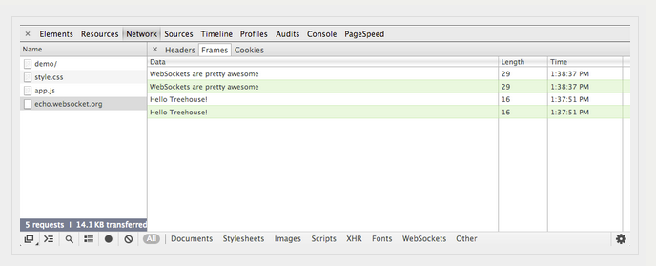
Monitoring WebSockets Traffic

Slide 34
WebSockets on Server
Javascript: socket.io
C++: libwebsockets
Errlang: Shirasu.ws
Java: Jetty, Grizlly
Node.JS: ws
Ruby: em-websocket
Python: Tornado, pywebsocket
PHP: Ratchet, phpws

Slide 35
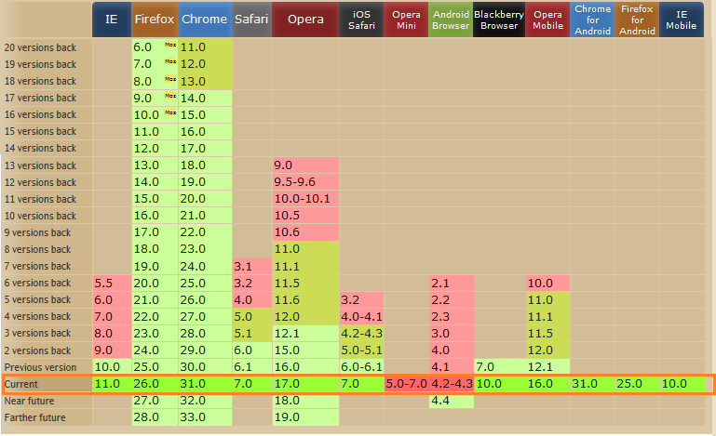
Browser Support for WebSockets

Slide 36
Java EE 7 – WebSockets Support
The Java EE platform includes the Java API for WebSocket (JSR-356), which enables you to create, configure, and deploy WebSocket endpoints in web applications.
The WebSocket client API specified in JSR-356 also enables you to access remote WebSocket endpoints from any Java application.
The Java API for WebSocket consists of the following packages:
  The javax.websocket.server package contains annotations, classes, and interfaces to create and configure server endpoints.
  The javax.websocket package contains annotations, classes, interfaces, and exceptions that are common to client and server endpoints.

Slide 37
Creating and Deploying a WebSocket endpoint
The process for creating and deploying a WebSocket endpoint is the following:
  Create an endpoint class.
  Implement the lifecycle methods of the endpoint.
  Add your business logic to the endpoint.
  Deploy the endpoint inside a web application.

Slide 38
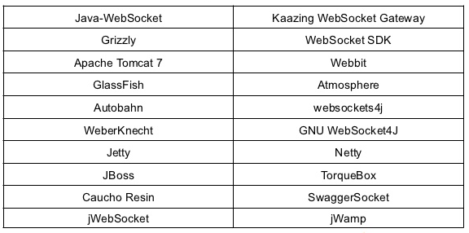
Java WebSocket Implementations

Slide 39
Basic API Tour

Slide 40
Hello World Server
public class HelloServer extends Endpoint {
@Override
public void onOpen(Session session,
EndpointConfig configuration) {
session.addMessageHandler(
new MessageHandler.Whole<String>() {
public void onMessage(String name) {
try {
session.getBasicRemote().sendText(“Hello “ + name);
} catch (IOException ioe) {
// Handle failure.
}
}
});
}
}
Notes:
A logical websocket endpoint is represented in the Java WebSocket API as an instance of the Endpoint class. Developers may subclass the Endpoint class in order to intercept lifecycle events of the endpoint: those of a peer connecting, a peer disconnecting and an error being raised during the lifetime of the endpoint.
The implementation must use at least one instance of the Endpoint class to represent the logical endpoint. Each instance of the Endpoint class may therefore handle connections to the endpoint from multiple peers. Some implementations may wish to use multiple instances of Endpoint to represent a logical endpoint, perhaps one instance per VM in a distributed server setting.
The Java WebSocket API models the sequence of interactions between an endpoint and each of its peers using an instance of the Session class. The interactions between a peer and an endpoint begin with an open notification, followed by some number, possibly zero, of web socket messages between the endpoint and peer, followed by a close notification or error terminal to the connection. For each peer that is interacting with an endpoint, there is one Session instance that represents that interaction. The Session instance corresponding to the peer is passed to the Endpoint instance representing the endpoint at the key events in its lifecycle.
40

Slide 41
Hello World Client
public class HelloClient extends Endpoint {
@Override
public void onOpen(Session session,
EndpointConfig configuration) {
try {
session.getBasicRemote().sendText("Hello you!");
} catch (IOException ioe) {
. . .
}
}
}
Notes:
The websocket protocol is a two-way protocol. Once established, the web socket protocol is symmetrical between the two parties in the conversation. The difference between a websocket ‘client’ and a websocket ‘server’ is only in the means by which the two parties are connected. In this specification, we will say that a websocket client is a websocket endpoint that initiates a connection to a peer. We will say that a websocket server is a websocket endpoint that is published an awaits connections from peers. In most deployments, a websocket client will connect to only one websocket server, and a websocket server will accept connections from several clients.
41

Slide 42
Client Server Configuration
ServerContainer serverContainer =
(ServerContainer) servletContext.getAttribute(
“javax.websocket.server.ServerContainer”);
ServerEndpointConfig serverConfiguration =
ServerEndpointConfig.Builder.create(
HelloServer.class, "/hello").build();
serverContainer.addEndpoint(serverConfiguration);
...
URI clientURI = new URI("ws://myserver.com/websockets/hello");
WebSocketContainer container =
ContainerProvider.getWebSocketContainer();
ClientEndpointConfig clientConfiguration =
ClientEndpointConfig.Builder.create().build();
container.connectToServer(HelloClient.class,
clientConfiguration, clientURI);
Notes:
The websocket protocol is a two-way protocol. Once established, the web socket protocol is symmetrical between the two parties in the conversation. The difference between a websocket ‘client’ and a websocket ‘server’ is only in the means by which the two parties are connected. In this specification, we will say that a websocket client is a websocket endpoint that initiates a connection to a peer. We will say that a websocket server is a websocket endpoint that is published an awaits connections from peers. In most deployments, a websocket client will connect to only one websocket server, and a websocket server will accept connections from several clients.
42

Slide 43
Sending the Message
Whole string * | RemoteEndpoint.Basic | sendText(String message)
Binary data * | RemoteEndpoint.Basic | sendBinary(ByteBuffer message)
String fragments | RemoteEndpoint.Basic | sendText(String part, boolean last)
Binary data fragments | RemoteEndpoint.Basic | sendBinary(ByteBuffer part, boolean last)
Blocking stream of text | RemoteEndpoint.Basic | Writer getSendWriter())
Blocking stream of binary data | RemoteEndpoint.Basic | OutputStream getSendStream()
Custom object | RemoteEndpoint.Basic | sendObject(Object customObject)
* additional flavors: by completion, by future

Slide 44
Receiving the Message
Whole string | MessageHandler.Whole<String> | onMessage(String message)
Binary data | MessageHandler.Whole<ByteBuffer> | onMessage(ByteBuffer message)
String fragments | MessageHandler.Partial<String> | onMessage(String part, boolean last)
Binary data fragments | MessageHandler.Partial<ByteBuffer> | onMessage(ByteBuffer part, boolean last)
Blocking stream of text | MessageHandler.Whole<Reader> | onMessage(Reader r)
Blocking stream of binary data | MessageHandler.Whole<InputSteam> | onMessage(InputStream r)
Custom object of type T | MessageHandler.Whole<T> | onMessage(T customObject)

Slide 45
POJO + Annotations

Slide 46
Hello World Annotations
@ServerEndpoint("/hello")
public class HelloBean {
@OnMessage
public String sayHello(String name) {
return “Hello “ + name;
}
}

Slide 47
WebSocket Annotations
Annotation | Level | Purpose
@ServerEndpoint | class | Turns a POJO into a WebSocket Server Endpoint
@ClientEndpoint | class | Turns a POJO into a WebSocket Client Endpoint
@OnOpen | method | Intercepts WebSocket Open events
@OnClose | method | Intercepts WebSocket Close events
@OnMessage | method | Intercepts WebSocket Message events
@PathParam | method parameter | Flags a matched path segment of a URI-template
@OnError | method | Intercepts errors during a conversation
Notes:
The annotation defines that the decorated method be called whenever a new client has connected to this endpoint. The container notifies the method after the connection has been established [WSC-21]. The decorated method can only have optional Session parameter and zero to n String parameters annotated with a @WebSocketPathSegment annotation as parameters. If the Session parameter is present, the implementation must pass in the newly created Session corresponding to the new connection [WSC-22]. If the method throws an error, the implementation must pass this error to the onError method of the endpoint together with the session.
The annotation defines that the decorated method be called whenever a new client is about to be disconnected from this endpoint. The container notifies the method before the connection is brought down [WSC-25]. The decorated method can only have optional Session parameter and zero to n String parameters annotated with a @WebSocketPathSegment annotation as parameters. If the Session parameter is present, the implementation must pass in the about-to-be ended Session corresponding to the connection [WSC-26]. If the method throws an error, the implementation must pass this error to the onError method of the endpoint together with the session.
The annotation defines that the decorated method be called whenever an error is generated on any of the connections to this endpoint. The decorated method can only have optional Session parameter, mandatory Throwable parameter and zero to n String parameters annotated with a @WebSocketPathSegment annotation as parameters. If the Session parameter is present, the implementation must pass in the Session in which the error occurred to the connection [WSC-XX]. The container must pass the error as the Throwable parameter to this method.
47

Slide 48
@ServerEndpoint attributes
value | Relative URI or URI template e.g. “/hello” or “/chat/{subscriber-level}”
configurator | Custom configuration
decoders | list of message decoder classnames
encoders | list of message encoder classnames
subprotocols | list of the names of the supported subprotocols

Slide 49
Custom Payloads
@ServerEndpoint(
value="/hello",
encoders={MyMessage.class},
decoders={MyMessage.class}
)
public class MyEndpoint {
. . .
}
Notes:
The encoders parameter contains a (possibly empty) list of Java classes that are to act as encoder components for this endpoint. These classes must implement some form of the Encoder interface, and have public no-arg constructors and be visible within the classpath of the application that this websocket endpoint is part of. The implementation must attempt to encode application objects of matching parametrized type as the encoder when they are attempted to be sent using the RemoteEndpoint API.
The decoders parameter contains a (possibly empty) list of Java classes that are to act as decoder components for this endpoint. These classes must implement some form of the Decoder interface, and have public no-arg constructors and be visible within the classpath of the application that this websocket endpoint is part of. The implementation must attempt to decode web socket messages using the first appropriate decoder in the list and pass the message in decoded object form to the websocket endpoint [WSC-17]. The implementation uses the willDecode() method on the decoder to determine if the Decoder will match the incoming message.
49

Slide 50
Custom Payloads – Text
public class MyMessage
implements Decoder.Text<MyMessage>, Encoder.Text<MyMessage> {
private JsonObject jsonObject;
public MyMessage decode(String s) {
jsonObject = new Json.createReader(
new StringReader(s)).readObject();
return this;
}
public boolean willDecode(String string) {
return true; // Only if can process the payload
}
public String encode(MyMessage myMessage) {
return myMessage.jsonObject.toString();
}
}

Slide 51
Custom Payloads – Binary
public class MyMessage
implements Decoder.Binary<MyMessage>, Encoder.Binary<MyMessage> {
public MyMessage decode(ByteBuffer bytes) {
. . .
return this;
}
public boolean willDecode(ByteBuffer bytes) {
. . .
return true; // Only if can process the payload
}
public ByteBuffer encode(MyMessage myMessage) {
. . .
}
}

Slide 52
Chat Sample
@ServerEndpoint("/chat")
public class ChatBean {
Set<Session> peers = Collections.synchronizedSet(…);
@OnOpen
public void onOpen(Session peer) {
peers.add(peer);
}
@OnClose
public void onClose(Session peer) {
peers.remove(peer);
}
...

Slide 53
Chat Sample (Continued)
. . .
@OnMessage
public void message(String message, Session client) {
for (Session peer : peers) {
peer.getBasicRemote().sendObject(message);
}
}
}

Slide 54
URI Template Matching
@ServerEndpoint(“/orders/{order-id}”)
public class MyEndpoint {
@OnMessage
public void processOrder(
@PathParam(“order-id”) String orderId) {
...
}
}

Slide 55
@OnMessage Methods
A parameter type that can be decoded in incoming message
  String, primitive, Reader, ByteBuffer, byte[], InputStream, or any type for which there is a decoder
An optional Session parameter
Boolean partial flag
0..n String parameters annotated with @PathParameter
A return type that can be encoded in outgoing message
  String, primitive, Reader, ByteBuffer, byte[], InputStream, or any type for which there is an encoder
Notes:
The method it decorates may have a number of forms
- The first String parameter in its parameter list must be called by the container using the String form of the incoming message, if in text form [WSC-29].
- The first byte parameter in its parameter list must be called by the container using the byte array form of the incoming message, if in binary form [WSC-30].
If the parameter list contains a Session parameter, the implementation must use the Session object corresponding to the connection on which the message arrived [WSC-31].
- The method may have zero to n String parameters annotated with @WebSocketPathParameter. The method may or may not have a return type. If the method has a return type, the implementation must treat this return object as a web socket message to be immediately sent back to the sender of the incoming message [WSC-32]. It uses the usual mechanism of checking its supply of encoders in order to handle return types other than String or byte[].
55

Slide 56
Demo
Notes:
The method it decorates may have a number of forms
- The first String parameter in its parameter list must be called by the container using the String form of the incoming message, if in text form [WSC-29].
- The first byte parameter in its parameter list must be called by the container using the byte array form of the incoming message, if in binary form [WSC-30].
If the parameter list contains a Session parameter, the implementation must use the Session object corresponding to the connection on which the message arrived [WSC-31].
- The method may have zero to n String parameters annotated with @WebSocketPathParameter. The method may or may not have a return type. If the method has a return type, the implementation must treat this return object as a web socket message to be immediately sent back to the sender of the incoming message [WSC-32]. It uses the usual mechanism of checking its supply of encoders in order to handle return types other than String or byte[].
56

Slide 57
References
http://www.websocket.org/quantum.html
http://blog.arungupta.me
https://developer.mozilla.org/en/docs/WebSockets
http://www.w3.org/TR/html5/
http://www.rahmannet.net/
http://www.oracle.com/technetwork/articles/java/jsr356-1937161.html

Slide 58


